Slide 1


SMS Spam Classifier: A Machine Learning Project
Welcome to the presentation of our SMS Spam Classifier project. This project aims to tackle the ever-growing problem of spam messages flooding our inboxes. We'll delve into the intricacies of how we built a machine learning model to automatically identify and filter spam messages, saving users time and frustration.

Slide 2

Overview of the Problem Statement
1
Irritating Spam
2
User Frustration
Spam messages have become a pervasive issue in our digital lives. These unwanted messages can range from promotional emails to phishing scams, often containing deceptive content and malicious links.
Spam messages can be a significant source of annoyance and frustration for users. They can clog up inboxes, waste time, and potentially pose security risks.
3
Economic Impact
4
Need for Filtering
Spam messages can also have a negative economic impact. Businesses lose time and resources dealing with spam, while individuals may fall victim to scams, leading to financial losses.
The need for effective spam filtering solutions is paramount. This project aims to develop a reliable and efficient spam classifier to protect users from the harmful effects of spam.

Slide 3

Data Collection and Preprocessing
1
Dataset Acquisition
We began by acquiring a comprehensive dataset of SMS messages, labeled as either spam or ham (non-spam). This dataset served as the foundation for training our machine learning model. Data set is from kagel
2
Data Cleaning
The next step involved cleaning the dataset by removing irrelevant information like stop words and punctuation. This process ensured that our model would focus on meaningful words relevant to classifying spam.
3
Feature Engineering
We then engineered features from the cleaned data by representing each message as a vector of words. This transformation allowed us to feed the data into our machine learning algorithm.

Slide 4
Natural Language Processing (NLP) Techniques
Tokenization
Stemming
Feature Extraction
This process involves breaking down each SMS message into individual words or tokens. Tokenization allows us to analyze and process each word separately.
We extract meaningful features from the processed text, such as word frequencies, character frequencies, and the presence of certain keywords. These features are used to train our model.
These techniques reduce words to their root forms, eliminating variations in spelling and grammar. This step helps to normalize the vocabulary and improve model accuracy.

Slide 5
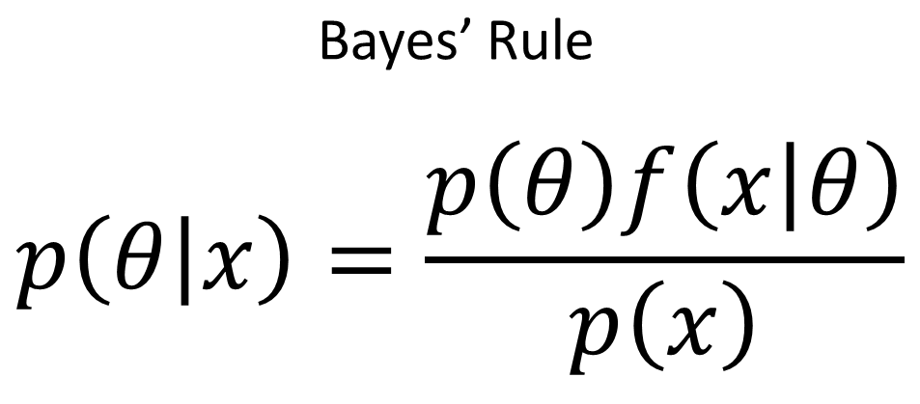
Naive Bayes Algorithm
Probability-Based Classification
Bayes' Theorem
The algorithm relies on Bayes' Theorem, which relates the probability of an event to prior probabilities and conditional probabilities. This theorem allows us to calculate the likelihood of a message being spam given the observed features.
The Naive Bayes algorithm is a probabilistic approach to classification. It calculates the probability of a message being spam based on the presence of certain words or features.
This Photo by Unknown Author is licensed under CC BY-SA-NC
Simplicity and Efficiency
Naive Bayes is known for its simplicity and efficiency, making it well-suited for large-scale text classification tasks like spam filtering. It requires relatively little training data and can provide accurate predictions.

Slide 6
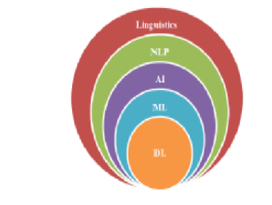



Model Training and Evaluation
Training Data Split
We split the dataset into training and testing sets. The training set is used to train the Naive Bayes model, while the testing set is used to evaluate its performance.
Model Training
The Naive Bayes model is trained on the training data, learning the relationships between words and the spam/ham classification. This involves adjusting the model's parameters to minimize prediction errors.
Model Evaluation
We evaluate the model's performance on the testing set using metrics like accuracy, precision, recall, and F1 score. These metrics provide insights into the model's ability to correctly identify spam and non-spam messages.

Slide 7





Streamlit GUI Development
User-Friendly Interface
Text Input
We developed a user-friendly graphical user interface (GUI) using Streamlit. The GUI provides a simple and intuitive way for users to interact with the spam classifier.
Users can input an SMS message into the GUI, and the model will analyze it and predict whether it is spam or ham.
Real-Time Classification
Visualization and Confidence Score
The GUI provides instant classification results, allowing users to determine the spam status of a message in real time.
The GUI presents the classification result along with a confidence score, indicating the model's level of certainty in its prediction.

Slide 8

Challenges and Limitations
1
Evolving Spam Tactics
2
New Words and Slang
3
False Positives
Spammers are constantly adapting their techniques, making it challenging to keep the model up-to-date and effective.
The emergence of new words, slang, and internet jargon can make it difficult for the model to recognize spam patterns.
In some cases, the model may incorrectly classify legitimate messages as spam, leading to user inconvenience and the potential loss of important information.

Slide 9

Conclusion and Future Enhancements
Our SMS Spam Classifier project successfully demonstrated the effectiveness of machine learning in combating spam. The project provides a valuable tool for filtering unwanted messages and improving the user experience. In the future, we plan to explore techniques for handling evolving spam tactics, enhancing the model's ability to adapt to new words and slang, and minimizing the occurrence of false positives.

